Slide 1

Student centred teacher training
Minna Mäkihonko
Senior lecturer
KONASPI VIII, Jakarta, Indonesia

Slide 2

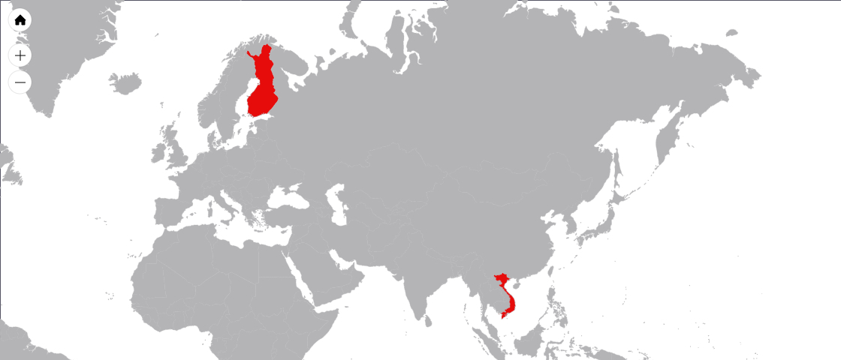
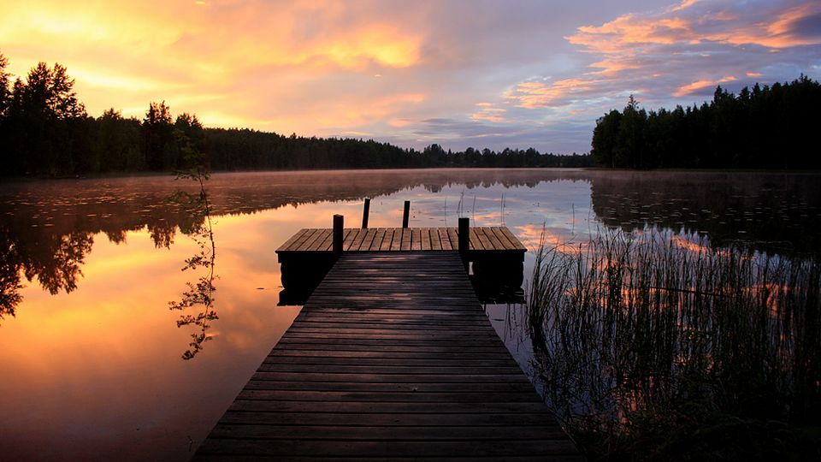
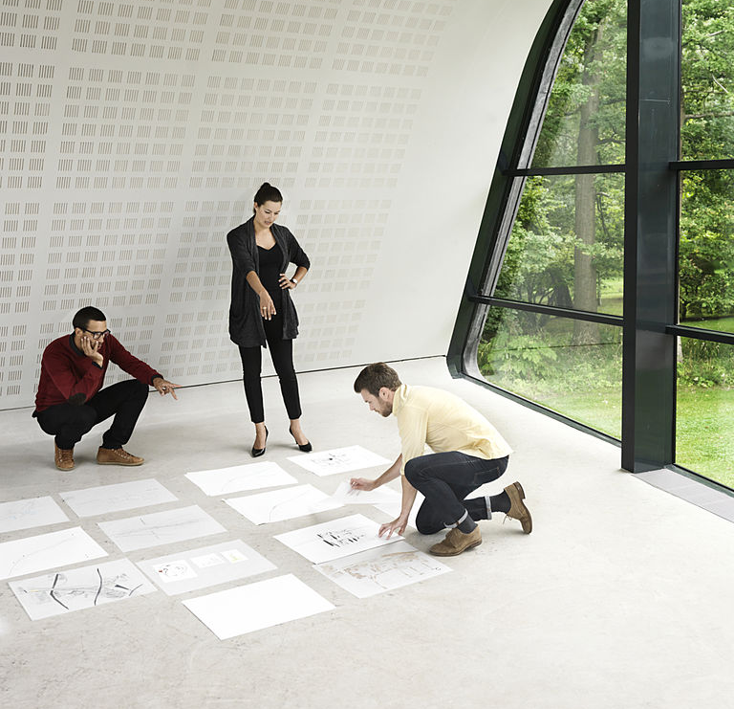

Finland in a nutshell
12h flight
Finland is an independent democracy (since 1917), is a core member of the European Union.
There are 5,5 million of us about 12 hour flight away from Indonesia.
65 percent of Finland’s total land area is covered with forests and we have almost 200 000 lakes.
You really can hear yourself think here!
We rank first in digitalization (Digibarometer 2016) and have continuously succeeded in PISA rankings – being 6th in 2012.
We rank number one in the world in Health and Education in Global Competitiveness Index
Everyone is treated equally; we rank among top three in Global Gender Gap Index 2016!
It’s not a wonder why Finland has the highest quality of life in the world (Social Progress Index 2016)
Notes:
Images by: jukal / www.flickr.com
License: Creative Commons License ()

Slide 3
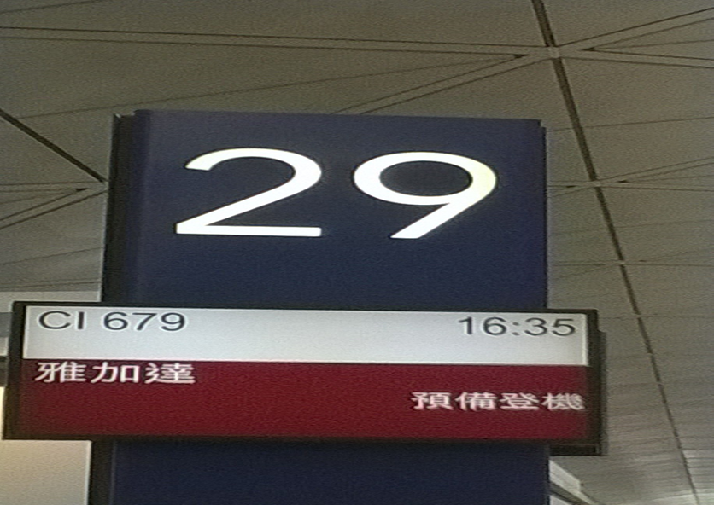
Problem solving skills

Slide 4

Inclusion – No one left behind

Slide 5
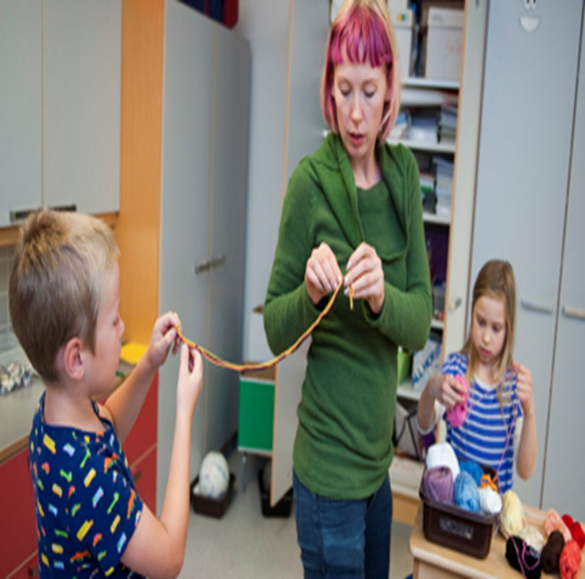
Formative assessment
high-quality interactions, based on thoughtful questions
careful listening
reflective responses
Notes:
Images by: jukal / www.flickr.com
License: Creative Commons License ()

Slide 6
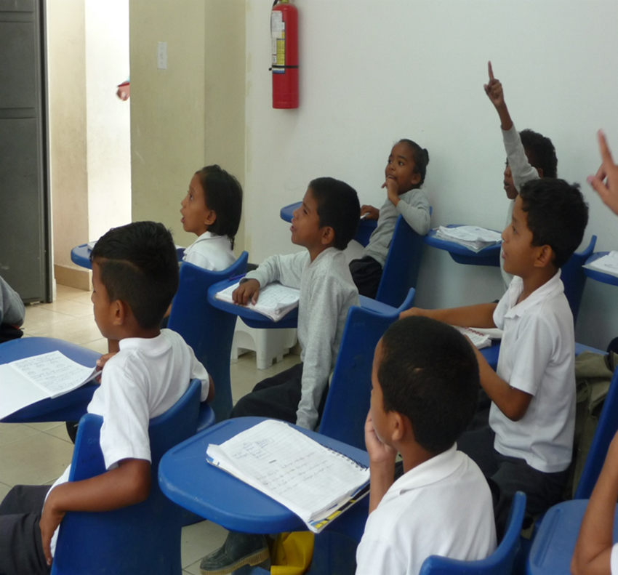
What is student-centred learning? (Lea et al, 2003)
Active rather than passive learning
Deep learning and understanding
Address diversity of learning
Responsibility and accountability on the part of the student
A dialogue between teacher and learner
Mutual respect within the learner-teacher relationship
A reflective approach to teaching and learning process
Notes:
Images by: jukal / www.flickr.com
License: Creative Commons License ()

Slide 7
Why student centred learning?

Slide 8
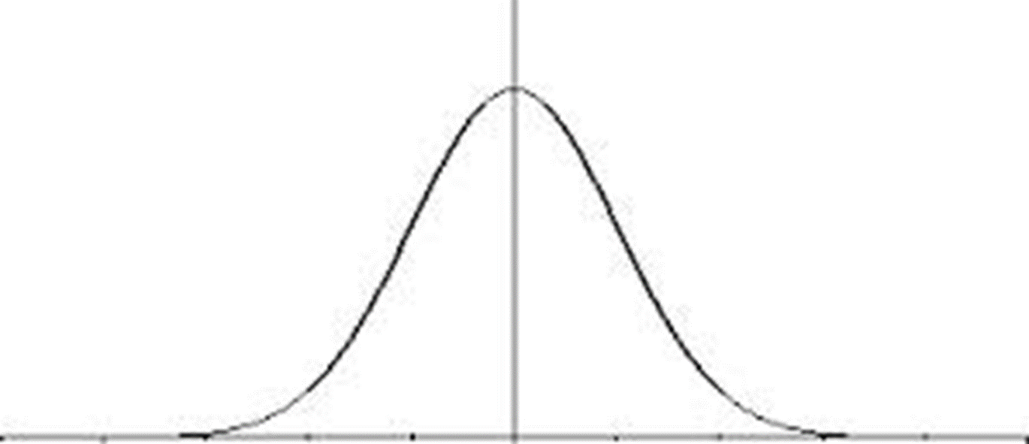
The Bell Curve

Slide 9
What is the process?
34 + 45 = 63
3 + 9
12 + 4
1+2
3 6 63

Slide 10

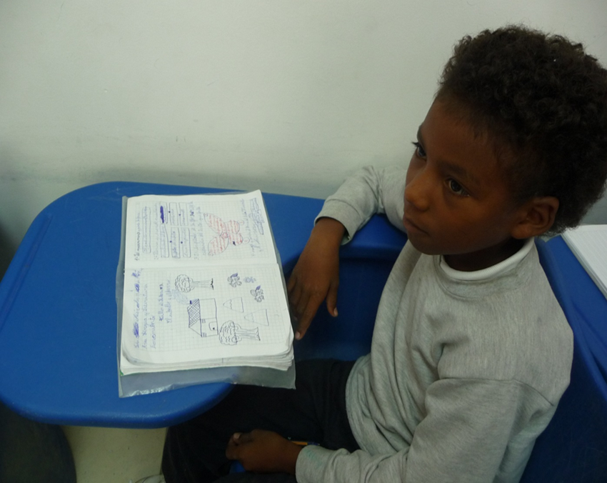
What is the process?
Teacher: How do you remember the result of calculation 8X8?
Student:
- ”So, I remember the result of calculation as follows:
- First 7 x 8 = 56.
- And then I remember that, there is number six both in results (7x8 and 8x8) but in different places.
- And then I remember that I have to substract 1 from number five. So the final result is 8 x 8 = 64.

Slide 11
Why student centered learning?
To increase motivation and engagement to learn
To increase students’ independence and responsibility of learning process
To increase understanding of students by teachers
To consider for students’ needs
To foster a lifelong learning culture
To support ongoing improvement process

Slide 12
Resources: What are the requirements for
Teachers training
curricula
Teacher students
Partner schools and
Labschools
Teacher trainers

Slide 13
For teacher training curriculum
Development of professional identity
Student centered approach
Evidence-based teaching practices
Subject specific pedagogy
Addressing the diversity in classrooms
Supporting students 'wellbeing and motivation
Mentoring teaching practice

Slide 14
For teacher trainers
Strong professional identity
Appropriate knowledge, competence and skills
Teacher’s reflection on teaching
Interaction with colleagues, learning in collaboration with others and sharing experience
Effective mentoring, especially during teaching practice
Applying and adapting educational theory to the practical work in school

Slide 15
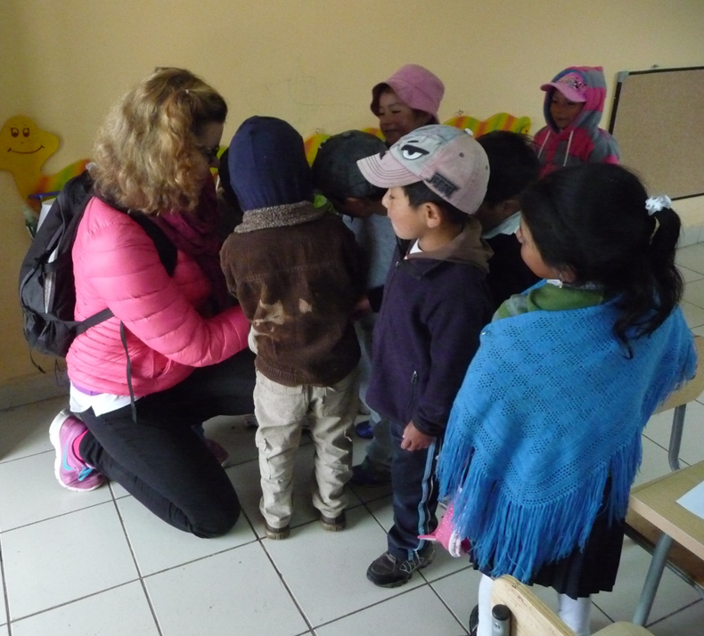
For the partner schools and labschools
Assume responsibility in the supervision and tutoring of student teachers during their internship
Act as leading educational institutions in the provision of teaching and learning
Be familiar with the central scientific, theoretical and ethical questions of mentoring
Be able to use various interactive mentoring practice, including media and ICT
Carry out a mentoring process that leads to professional growth towards full teacher accreditation.

Slide 16
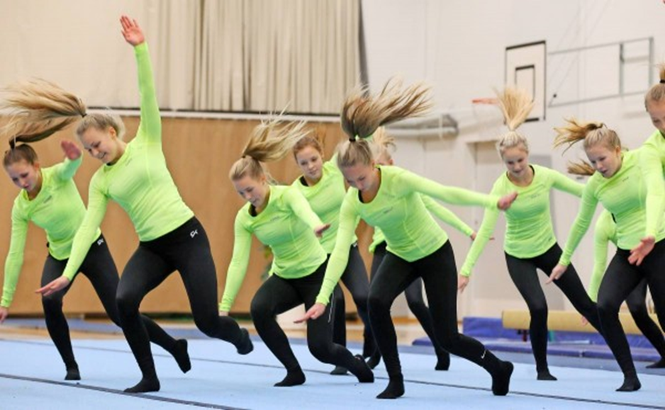
From teacher students
Motivation and commitment of the applicant to the field of education and teaching
Potential of the applicant to successfully meet the learning aims and complete the studies
Interaction, communication, cooperation, and problem solving skills.

Slide 17
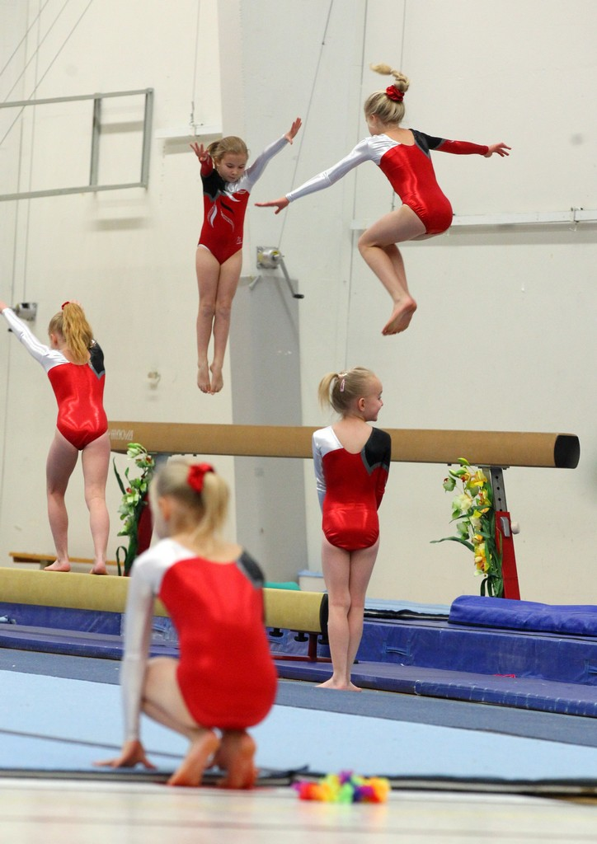


We are the world.
We are the children.
Notes:
Images by: jukal / www.flickr.com
License: Creative Commons License ()

Slide 18
Minna Mäkihonko www.finlanduniversity.fi

